Slide 1
ASP.Net Core –The binding model: retrieving and validating user input
Kamal Beydoun
Lebanese University – Faculty of Sciences I
Kamal.beydoun@ul.edu.lb

Slide 2
Understanding the M in MVC
The classic MVC design pattern has three independent components:
Controller—Calls methods on the model and selects a view.
View—Displays a representation of data that makes up the model.
Model—The data to display and the methods for updating itself.
In this representation, there’s only one model, which represents all the business logic for the application as well as how to update and modify its internal state.
ASP.NET Core MVC has a number of different models.
Notes:
“plain old CLR object” (POCO).
ASP.NET Core MVC has a number of different models, most of which are POCOs, and the application model, which is more of a concept around a collection of services.

Slide 3
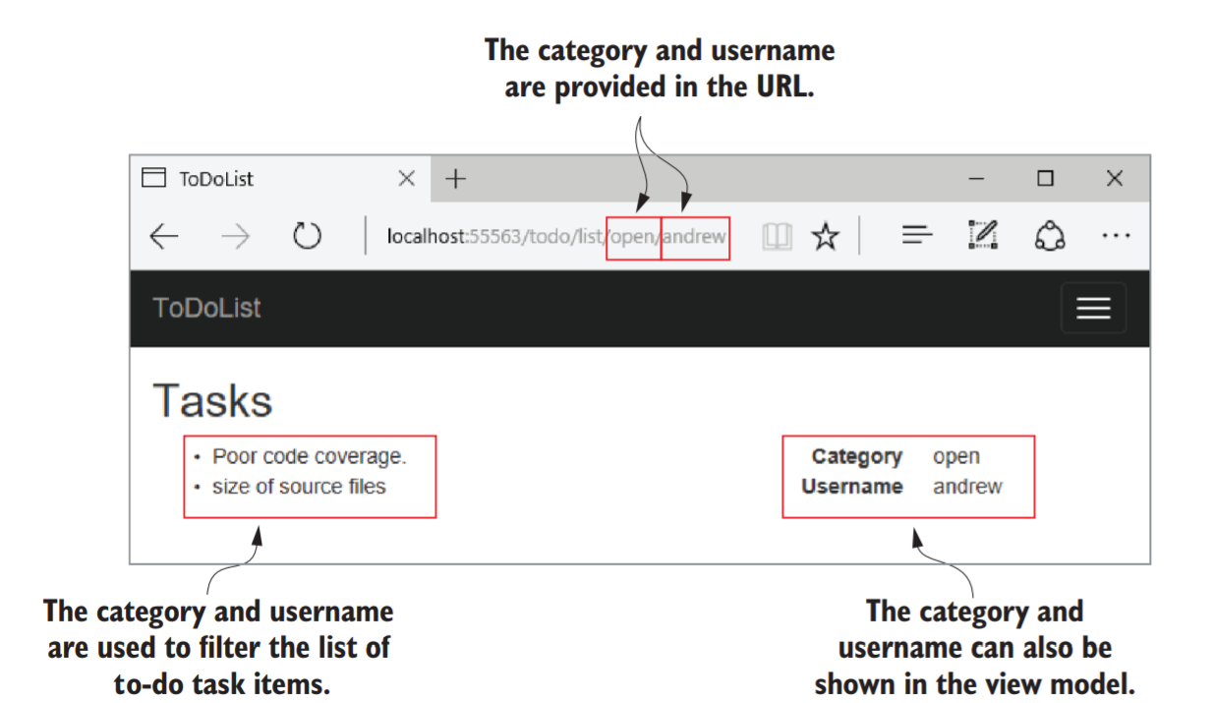

Slide 4
Models in ASP.net Core MVC: Binding model
Information provided by the user when making a request, as well as additional contextual data.
route parameters parsed from the URL,
the query string, and
form or JSON data
It is one or more .NET objects that you define.
It is passed to a controller’s action method as parameters when it’s executed.
Notes:
For this example, the binding model would include the name of the category, open, and the username, Andrew. The MvcMiddleware inspects the binding model before the action method executes to check whether the provided values are valid, though the method will execute even if they’re not.

Slide 5
Models in ASP.net Core MVC: Application model
This is typically a whole group of different services and classes
anything needed to perform some sort of business action in your application.
It may include the domain model (which represents the thing your app is trying to describe) and database models (which represent the data stored in a database), as well as any other additional services.
Notes:
In the to-do list application, the application model would contain the complete list of to-do items, probably stored in a database, and would know how to find only those to-do items in the open category assigned to Andrew.
Modeling your domain is a huge topic, with many different possible approaches, so it’s outside the scope of this book, but we’ll touch briefly on creating database models in chapter 11.

Slide 6
Models in ASP.net Core MVC: View model
This contains the data needed by the view to generate a response, such as the list of to-dos in the open category assigned to Andrew.
It often also contains extra data, such as the total number of to-dos in all categories.

Slide 7
Models in ASP.net Core MVC: API model
A variation on the view model, in which the whole model represents the data to return.
Web API controllers use this to generate the final response to return to the caller, normally in the form of a JSON or XML response.
Notes:
The main difference between API models and view models is that API models contain only the data to return, whereas view models often contain additional information related to generating the view. You define both types of model, and both can be POCOs.

Slide 8
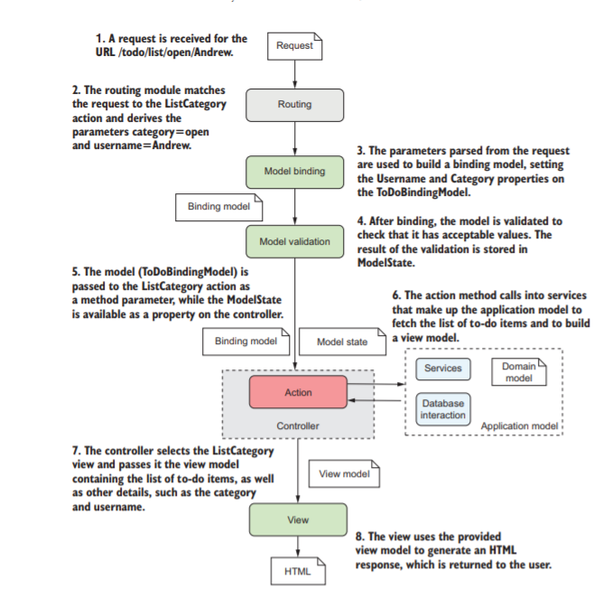

Slide 9
Example
/search/{query} URL, where {query} holds search terms
Binding model—Would take the {query} route parameter from the URL and any values posted in the request body and bind them to a C# class.
Application model—The services and classes that perform the logic.
return the results back to the controller.
View model—The values provided by the application model would be added to the view model, along with other metadata.
Notes:
When invoked by the action method, this would load all the clothes that match the query, applying the necessary sorting and filters, and return the results back to the controller.
This chapter looks at the binding models that are built from incoming requests—how are they created, and where do the values come from?

Slide 10
From request to model: making the request useful
Model binding extracts values from a request and uses them to create .NET objects that are passed as method parameters to the action being executed.
The MvcMiddleware can automatically populate your binding models using
URL , any headers sent in the HTTP request, data explicitly POSTed in the request body, and so on.

Slide 11
From request to model: making the request useful
By default, MVC uses three different binding sources when creating binding models. It will look through each of these in order and will take the first value it finds (if any) that matches the name of the parameter.
Form values —Sent in the body of an HTTP request when a form is sent to the server using a POST.
Route values —Obtained from URL segments or through default values after matching a route.
Query string values —Passed at the end of the URL, not used during routing.

Slide 12
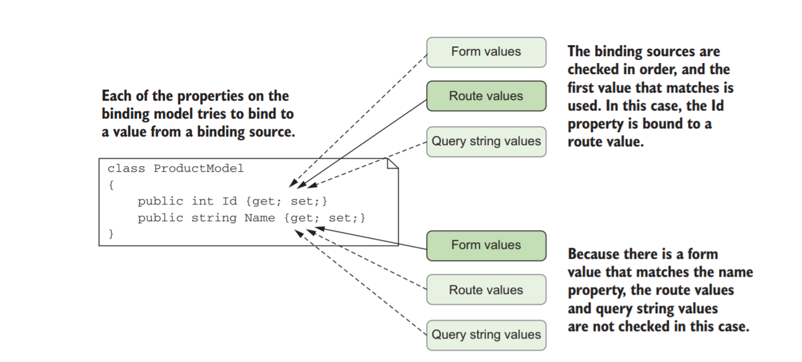
Model Binder Order
The model binder checks each binding source to see if it contains a value that could be set on the model.
Each of these binding sources store values as name-value pairs.
Notes:
The model binder checks each binding source to see if it contains a value that could be set on the model. Alternatively, the model can also choose the specific source the value should come from, as you’ll see later in this section. Once each property is bound, the model is validated and is passed to the action method to execute it.
Model binding is great for reducing repetitive code. Take advantage of it whenever possible and you’ll rarely find yourself having to access the Request object directly.

Slide 13
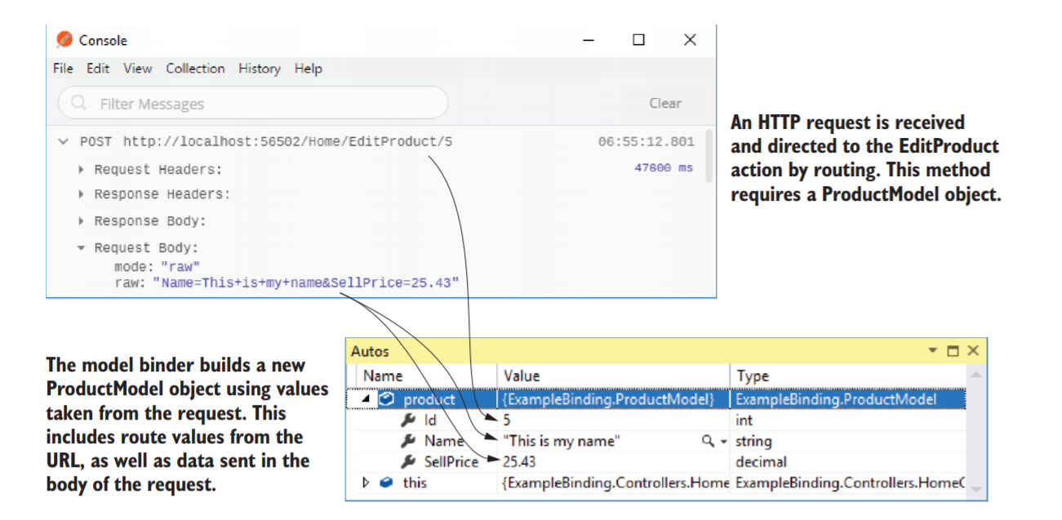
Example
public IActionResult EditProduct(ProductModel product)
Notes:
The Id property has been bound from a URL route parameter, but the Name and SellPrice have been bound from the request body. The big advantage of using model binding is that you don’t have to write the code to parse requests and map the data yourself. This sort of code is typically repetitive and error-prone, so using the built-in conventional approach lets you focus on the important aspects of your application: the business requirements.

Slide 14
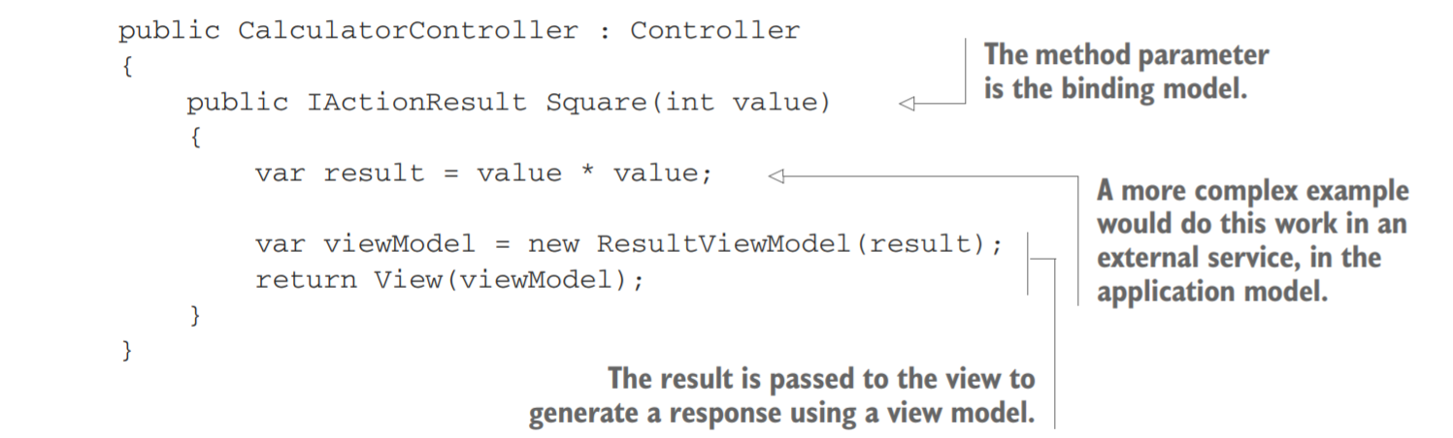
Binding simple types
{controller}/{action}/{value}
/Calculator/Square/5
Notes:
The router only uses the controller and action parameters for routing, but all the values are stored in a collection as name-value pairs.
This action method contains a single parameter—an integer called value—which is your binding model. When the MvcMiddleware executes this action method, it will spot the expected parameter, flick through the route values associated with the request, and find the value=5 pair.
The key thing to appreciate is that you didn’t have to write any extra code to try to extract the value from the URL when the method executed.

Slide 15
Default Values
If none of the binding sources contain the required value, then the method parameter receives a new instance of the type instead.
For value types, the value will be default(T).
For an int parameter this would be 0, and for a bool it would be false.
For reference types, the type is created using the default constructor.
For custom types like ProductModel, that will create a new object.
For nullable types like int? or bool?, the value will be null.
For string types, the value will be null.
Notes:
It’s important to consider the behavior of your action method if model binding fails to bind your method parameters. If none of the binding sources contain the value, the value passed to the method could be null, or have an unexpected default value.

Slide 16
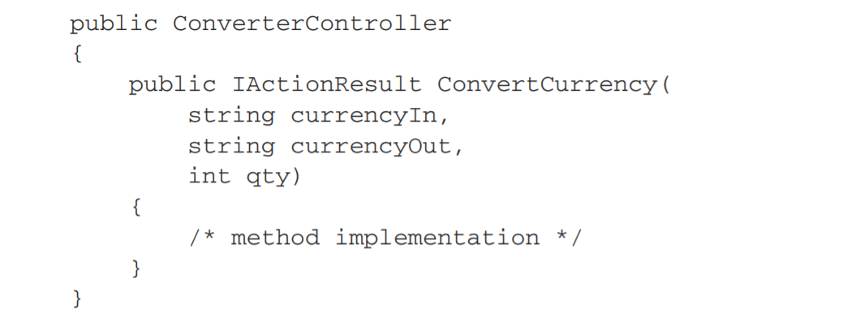
multiple binding parameters
"{currencyIn}/{currencyOut}"
Values stored in binding sources are all strings.
Notes:
The model binder will convert pretty much any primitive .NET type such as int, float, decimal (and string obviously), plus anything that has a TypeConverter.

Slide 17
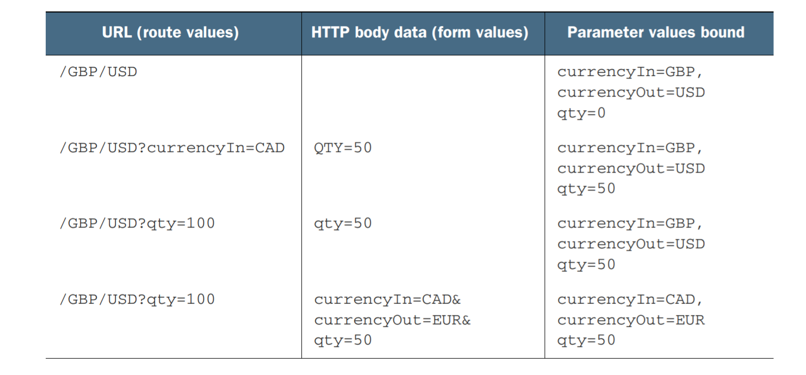
Examples
Notes:
The default model binder isn’t case sensitive, so a binding value of QTY=50 will happily bind to the qty parameter.

Slide 18
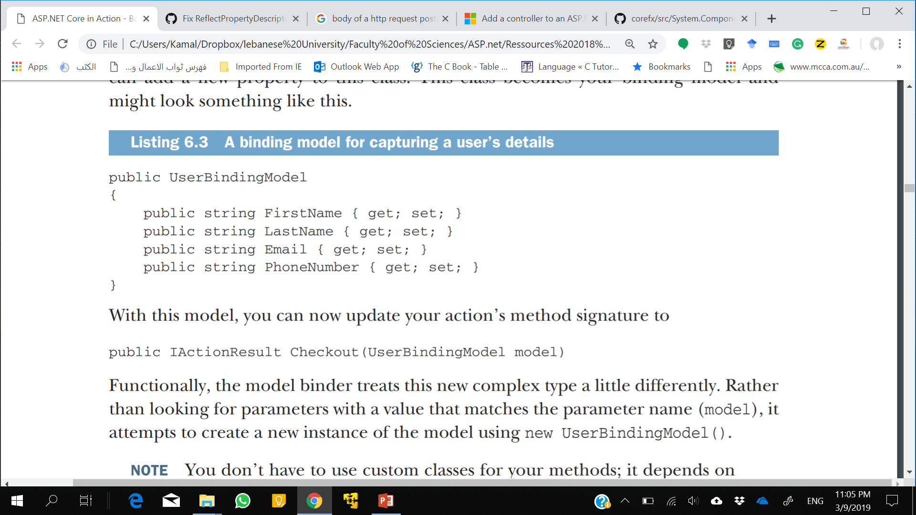
Binding complex types
public IActionResult Checkout (string firstName, string lastName, string phoneNumber, string email)
Rather than looking for parameters with a value that matches the parameter name (model), it attempts to create a new instance of the model using new UserBindingModel().
Notes:
Four parameters might not seem that bad right now, but what happens when the requirements change and you need to collect other details?
→extract a class that encapsulates the data the method requires.
Next, the model binder loops through all the properties your model exposes, such as FirstName and LastName. For each of these properties, it consults the collection of binding sources and attempts to find a name-value pair that matches. If it finds one, it sets the value on the property and moves on to the next.
For a class to be model-bound, it must have a default public constructor. You can only bind properties which are public and settable.

Slide 19
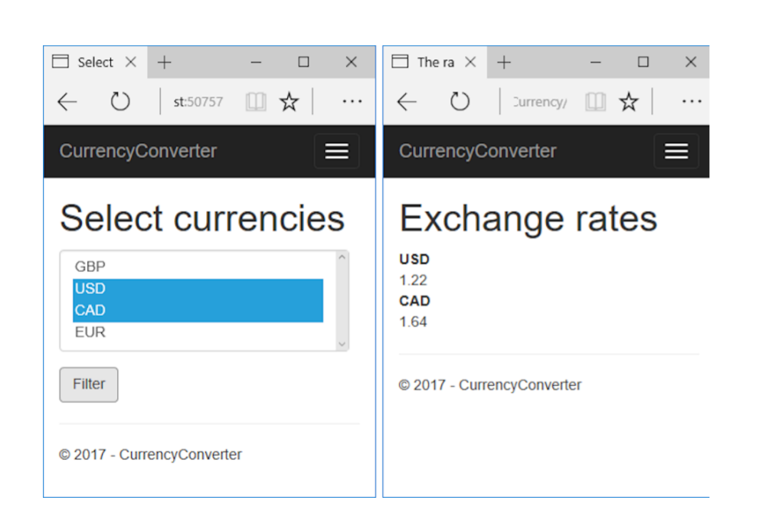
Binding Collections
IActionResult ShowRates(List<string> currencies);

Slide 20
Posting values
You could POST data to this method by providing values in a number of different formats:
currencies[index]—Where currencies is the name of the parameter to bind for example, currencies[0]= GBR&currencies[1]=USD.
[index]—If there’s only a single list, you can omit the name of the parameter, for example, [0]=GBR&[1]=USD.
currencies—Alternatively, you can omit the index and send currencies as the key value for every value, for example, currencies=GBR&currencies=USD.
Notes:
If this all seems a bit confusing, don’t feel too alarmed. If you’re building a traditional web application, and using Razor views to generate HTML, then it will take care of most of the naming for you. As you’ll see in chapter 8, the view will ensure that any
form data you POST will be generated in the correct format.

Slide 21
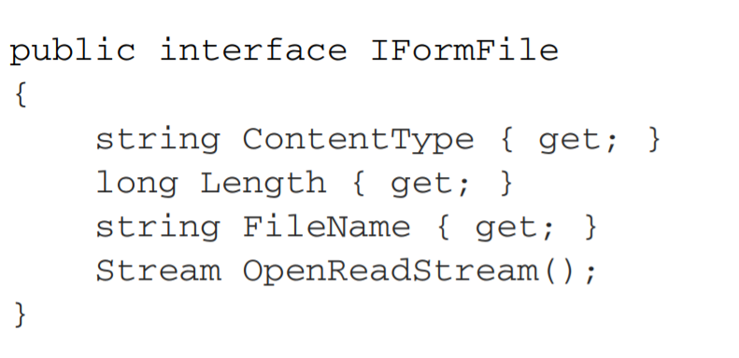
Binding File Uploads
public IActionResult UploadFile(IFormFile file);
public IActionResult UploadFiles(IEnumerable file);
When your method accepts an IFormFile instance, the whole content of the file is buffered in memory and on disk before you receive it.
You can then use the OpenReadStream method to read the data out.
Notes:
As you can see, this interface exposes a FileName property, which returns the filename that the file was uploaded with. But you know not to trust users, right? You should never use the filename directly in your code—always generate a new filename for the
file before you save it anywhere.

Slide 22
Choosing a binding source
In ASP.NET Core, three different binding sources: form data, route data, and the query string.
But we can bind a method parameter to a request header value, to JSON-formatted data in a request, etc..
Decorate your action method parameters (or binding model class properties) with attributes that say where to bind from.

Slide 23
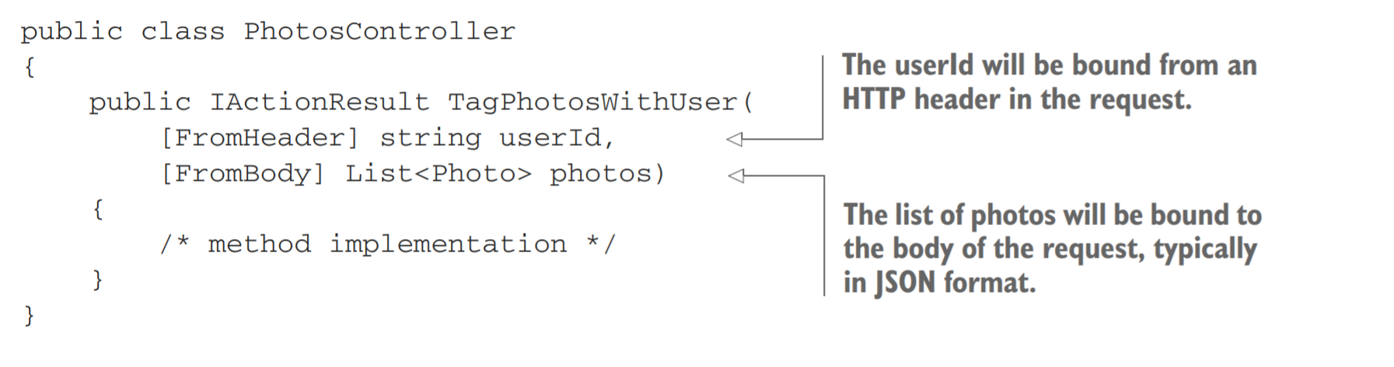
Example
Developers familiar with the previous version of ASP.NET should take note that the [FromBody] attribute is explicitly required when binding to JSON requests.
Notes:
In this example, an action method updates a collection of photos with a user. You’ve got method parameters for the ID of the user to tag in the photos, userId, and a list of Photo objects to tag, photos.
The [FromHeader] attribute has been applied to the userId parameter. This tells the model binder to bind the value to an HTTP request header value called userId. You’re also binding a list of photos to the body of the HTTP request by using the [FromBody] attribute. This will read JSON from the body of the request and will bind it to the List method parameter.
You aren’t limited to binding JSON data from the request body—you can use other formats too, depending on which InputFormatters you configure the MvcMiddleware to use. By default, only a JSON input formatter is configured. You’ll see how to add an XML formatter in chapter 9, when I discuss Web APIs.

Slide 24
Binding Source Attributes
[FromHeader]—Bind to a header value
[FromQuery]—Bind to a query string value
[FromRoute]—Bind to route parameters
[FromForm]—Bind to form data posted in the body of the request
[FromBody]—Bind to the request’s body content

Slide 25
Binding Source Attributes
You can apply each attribute to any number of method parameters.
BUT only one parameter may be decorated with the [FromBody] attribute.
[FromBody] and [FromForm] attributes are effectively mutually exclusive.

Slide 26
Binding Source Attributes
[BindNever]—The model binder will skip this parameter completely.
[BindRequired]—If the parameter was not provided, or was empty, the binder will add a validation error.
[FromServices]—Used to indicate the parameter should be provided using dependency injection.
Notes:
In addition, you’ve got the [ModelBinder] attribute, which puts you into “God mode” with respect to model binding. With this attribute, you can specify the exact binding source, override the name of the parameter to bind to, and specify the type of binding to perform. It’ll be rare that you need this one, but when you do, at least it’s there!

Slide 27
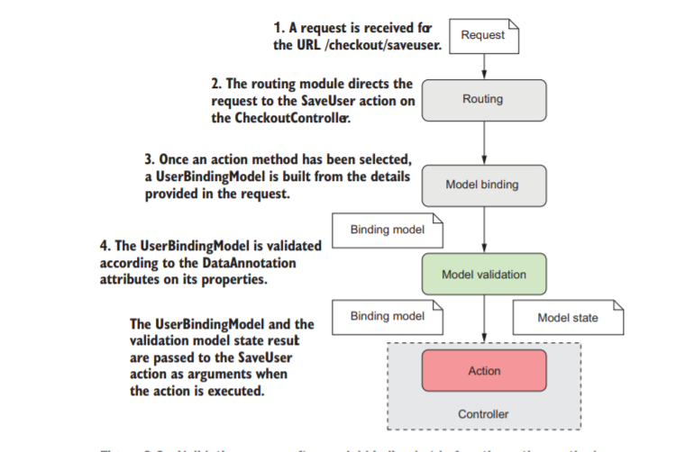
Handling user input with model validation
You should always validate data provided by users before you use it in your methods.
You have no idea what the browser may have sent you.

Slide 28
Why Validation ?
Not only to check for security threats ! It’s also needed to check for non malicious errors, such as:
Data should be formatted correctly.
Numbers might need to be in a particular range.
Some values may be required but others are optional.
Values must conform to your business requirements (you can’t convert a currency to itself, it needs to be converted to a different currency).
Notes:
Unfortunately, although this client-side validation is useful for users, as it gives them instant feedback, you can never rely on it, as it will always be possible to bypass these browser protections. It’s always necessary to validate the data as it arrives at your web application, using server-side validation.

Slide 29
Validation using DataAnnotations attributes
They provide metadata about your model by describing the sort of data the model should contain.
Apply DataAnnotations attributes directly to your binding models properties to indicate the type of data that’s acceptable.

Slide 30
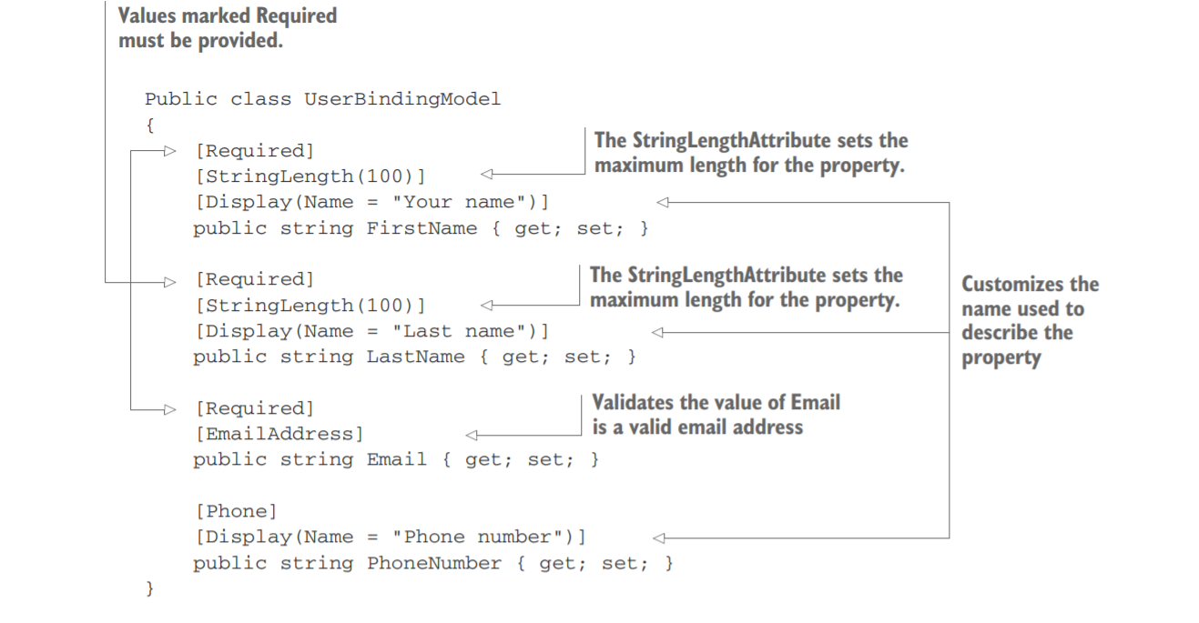
Example
Notes:
For example, you’ve specified that the FirstName property should always be provided, that it should have a maximum length of 100
characters, and that when it’s referred to (in error messages, for example) it should be called "Your name" instead of "FirstName".

Slide 31
DataAnnotations
[CreditCard]—Validates that a property has a valid credit card format
[EmailAddress]—Validates that a property has a valid email address format
[StringLength(max)]—Validates that a string has at most the max amount of characters
[MinLength(min)]—Validates that a collection has at least the min amount of items
[Phone]—Validates that a property has a valid phone number format
Notes:
but you can find more in the System.ComponentModel.DataAnnotations namespace. . I recommend using IntelliSense in Visual Studio/Visual Studio Code, or you can always look at the source code directly on GitHub (http://mng.bz/7N7s).
They’re also used for other purposes, in addition to validation. Entity Framework Core (among others) uses DataAnnotations to define the types of column and rule to use when creating database tables from C# classes. Y

Slide 32
DataAnnotations
[Range(min, max)]—Validates that a property has a value between min and max
[RegularExpression(regex)]—Validates that a property conforms to the regex regular expression pattern
[Url]—Validates that a property has a valid URL format
[Required]—Indicates the property that must be provided
[Compare]—Allows you to confirm that two properties have the same value (for example, Email and ConfirmEmail
Notes:
You can find more in the System.ComponentModel.DataAnnotations namespace.
I recommend using IntelliSense in Visual Studio/Visual Studio Code, or you can always look at the source code directly on GitHub (http://mng.bz/7N7s).
They’re also used for other purposes, in addition to validation. Entity Framework Core (among others) uses DataAnnotations to define the types of column and rule to use when creating database tables from C# classes. Y

Slide 33
Alternative libraries
Alternatively, if you’re not a fan of the attribute-based approach, the MvcMiddleware is flexible enough that you can replace the validation infrastructure with your preferred technique.
For example, you could use the popular FluentValidation library (https://github.com/JeremySkinner/FluentValidation) in place of the DataAnnotations attributes if you prefer.

Slide 34
Validating on the server for safety
Validation happens automatically but handling validation failures is the responsibility of the action method.
MvcMiddleware stores the output of the validation attempt in a property on the ControllerBase base class called ModelState.
This object is a ModelStateDictionary, which contains a list of all the validation errors that occurred after model binding, as well as some utility properties for working with it.

Slide 35
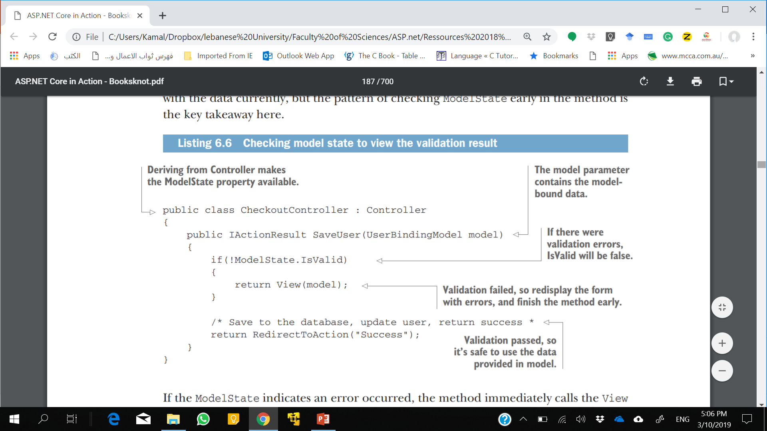
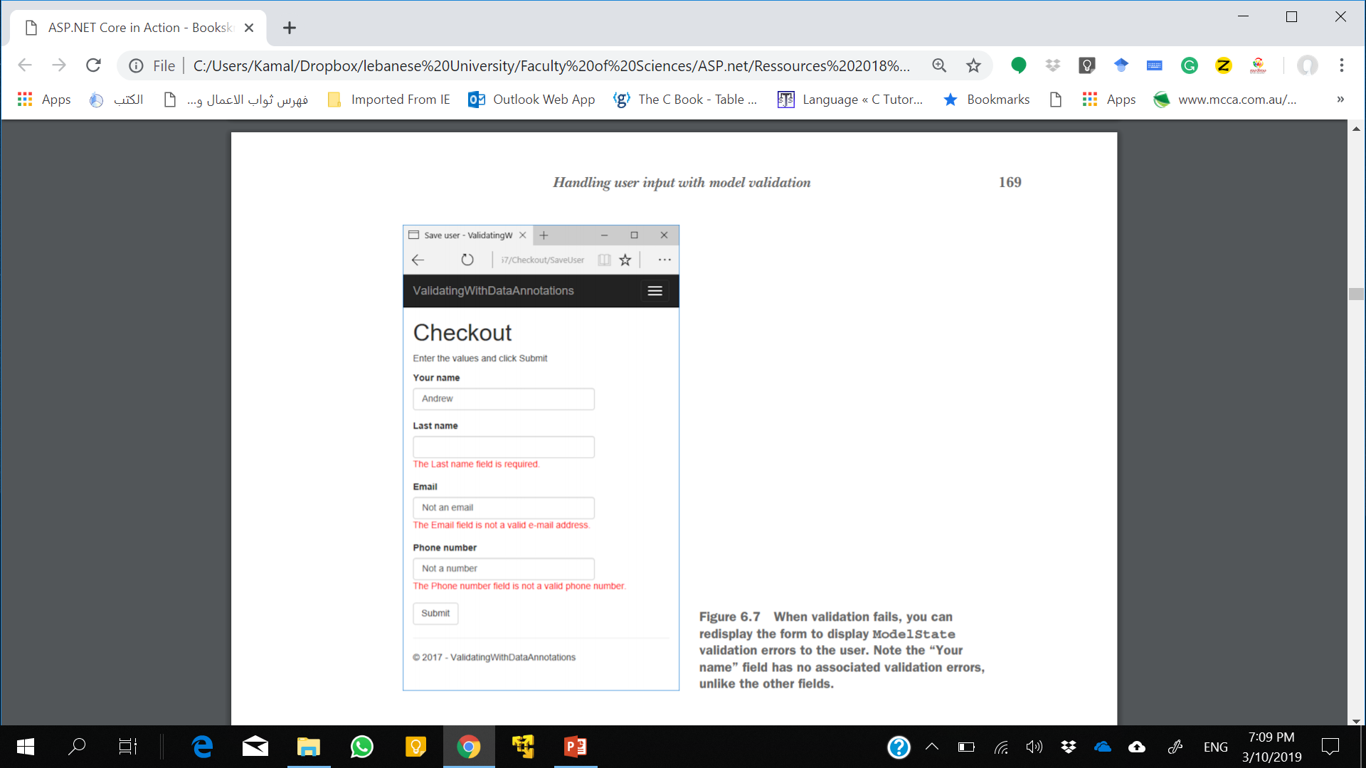
Example
Customize the displayed message by setting the ErrorMessage property on any of the validation attributes. For example, using [Required(ErrorMessage= "Required")].
Notes:
If the ModelState indicates an error occurred, the method immediately calls the View helper method, passing in the model. This will return a ViewResult that will ultimately generate HTML to return to the user, as you saw in chapter 4.
By passing in the model, the view can repopulate the values the user provided in the form when it’s displayed, as shown in figure 6.7. Also, helpful messages to the user can be added using the validation errors in the ModelState.
If the request is successful, the action method returns a RedirectToAction result that will redirect the user to the Success action on the CheckoutController. This pattern of returning a redirect response after a successful POST is called the POSTREDIRECT-GET pattern.
For traditional web apps however, you typically still want to generate an HTML response, even when validation failed. This allows the user to see the problem, and potentially correct it. This is often harder to make automatic, especially as the view model you use to generate your view and the binding model that’s validated are often different classes.
By including the IsValid check explicitly in your action methods, it’s easier to control what happens when other validation fails. If the user tries to update a product, then you won’t know whether the requested product ID exists as part of the DataAnnotations validation, only whether the ID has the correct format. By moving the validation to the action method, you can treat data and business rule validation failures similarly.

Slide 36
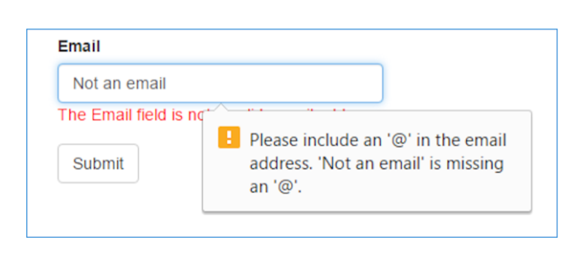
Client-Side Validation
HTML5 has several built-in validation behaviors.
The alternative approach is to perform client-side validation by running JavaScript
default approach used in ASP.NET Core MVC when you’re building a traditional web application.

Slide 37
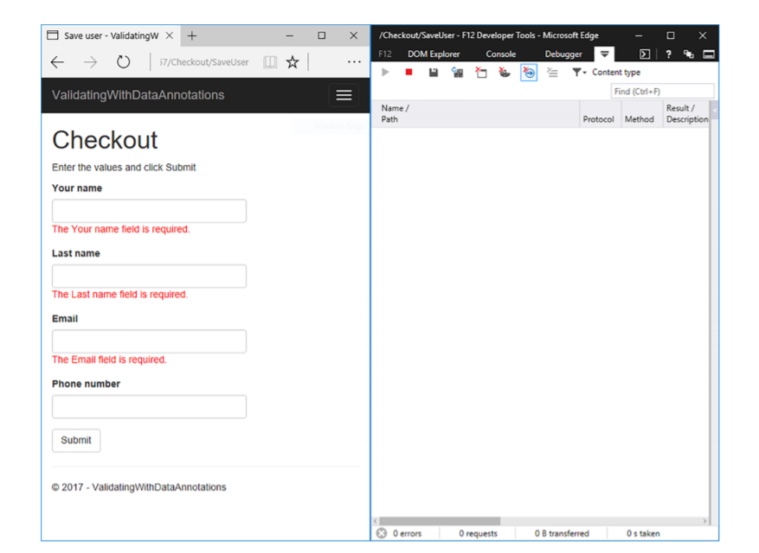
Client-Side Validation
By decorating a view model with DataAnnotations attributes.
With this approach, the user sees any errors with their form immediately, even before the request is sent to the server.
Notes:
By decorating a view model with DataAnnotations attributes, you provide the necessary metadata to the Razor engine for it to generate the appropriate HTML.

Slide 38
Summary
ASP.NET Core MVC has three distinct models, each responsible for a different aspect of a request. The binding model encapsulates data sent as part of a request, the application model represents the state of the application, and the view model contains data used by the view to generate a response.
Model binding extracts values from a request and uses them to create .NET objects to pass as method parameters to the action being executed.
By default, there are three binding sources: POSTed form values, route values, and the query string. The binder will interrogate these in order when trying to bind an action method parameter.

Slide 39
Summary
When binding values to parameters, the names of the parameters aren’t case sensitive.
You can bind to simple method parameter types or to the properties of complex types.
To bind complex types, they must have a default constructor and public, settable properties.
Collections and dictionaries can be bound using the [index]=value and [key]=value syntax, respectively.
You can customize the binding source for an action parameter using [From*] attributes applied to the method, such as [FromHeader] and [FromBody]. These can be used to bind to nondefault binding sources, such as headers or JSON body content.
In contrast to the previous version of ASP.NET, the [FromBody] attribute is required when binding JSON properties (previously it was not required).

Slide 40
Summary
When binding values to parameters, the names of the parameters aren’t case sensitive.
You can bind to simple method parameter types or to the properties of complex types.
To bind complex types, they must have a default constructor and public, settable properties.
Collections and dictionaries can be bound using the [index]=value and [key]=value syntax, respectively.
You can customize the binding source for an action parameter using [From*] attributes applied to the method, such as [FromHeader] and [FromBody]. These can be used to bind to nondefault binding sources, such as headers or JSON body content.
In contrast to the previous version of ASP.NET, the [FromBody] attribute is required when binding JSON properties (previously it was not required).

Slide 41
Summary
Validation is necessary to check for security threats. Check that data is formatted correctly, confirm it conforms to expected values and that it meets your business rules.
ASP.NET Core provides DataAnnotations attributes to allow you to declaratively define the expected values.
Validation occurs automatically after model binding, but you must manually check the result of the validation and act accordingly in your action method by interrogating the ModelState property.
Client-side validation provides a better user experience than server-side validation alone, but you should always use server-side validation.
Client-side validation uses JavaScript and attributes applied to your HTML elements to validate form values.

Slide 42
Examples from Ebook

